Slide 1
How to
This ‚How to‘ explains the use of the model and its peripheric code
Don’t be afraid everything is explained step-by-step!
The first part is about running the model the first time
The second part describe how to change the models scenarios
Third part is an outlook for changing the model

Slide 2
1) Use 2) Info
You need MATLAB 2020b to run the model.
To open the lists you need a program for opening .xlsx and .csv
First download the root with the model and its documents
Here the explanation text of the screenshots is given.
When there are numbers the text is for the numbers in the screenshot.
The headline 1) ‚How to use‘ is for an action for example pressing a button or enter new variables. If there is a ‚Info’ as a headline, like you can see in 2) it is at this point just/mainly for information

Slide 3
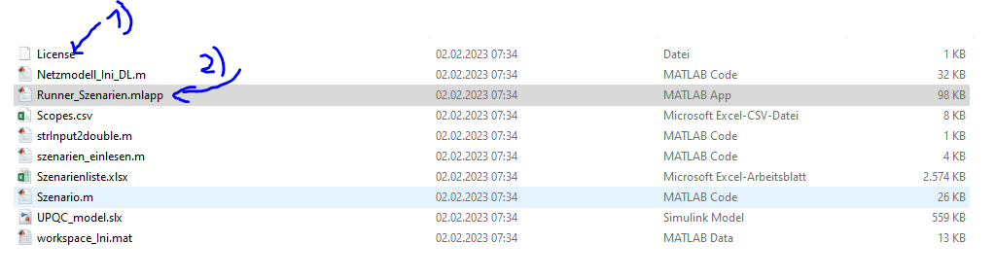
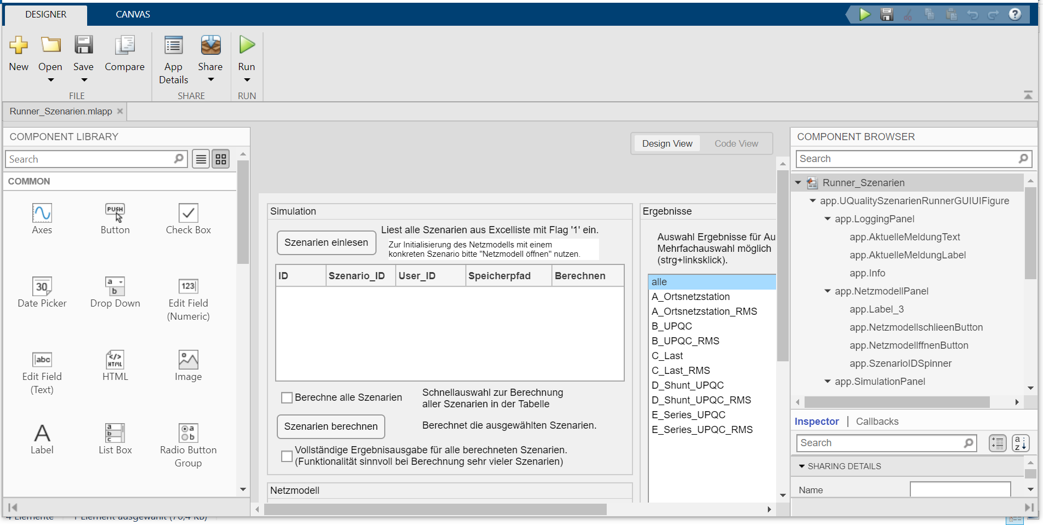
Use Files
How to first steps:
Please read the license document first
You can start now the app with the name ‚Runner_Szenarien.mlapp‘ with a double-click (or right click and chose start with Matlab 2020b)
If there is a App designer screen, run the app!
3)

Slide 4
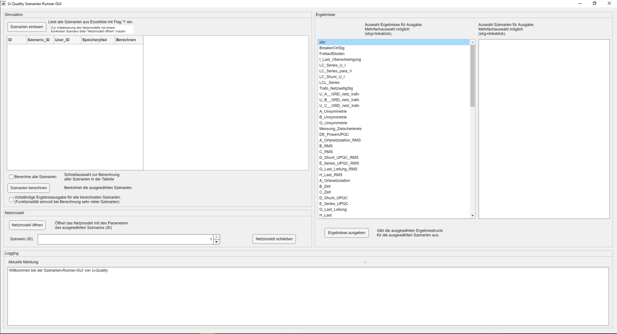
Info
MATLAB will start and this app Screen is displayed…
This app you can use for the read in of scenarios and to save results of the scopes in the model without opening the model

Slide 5
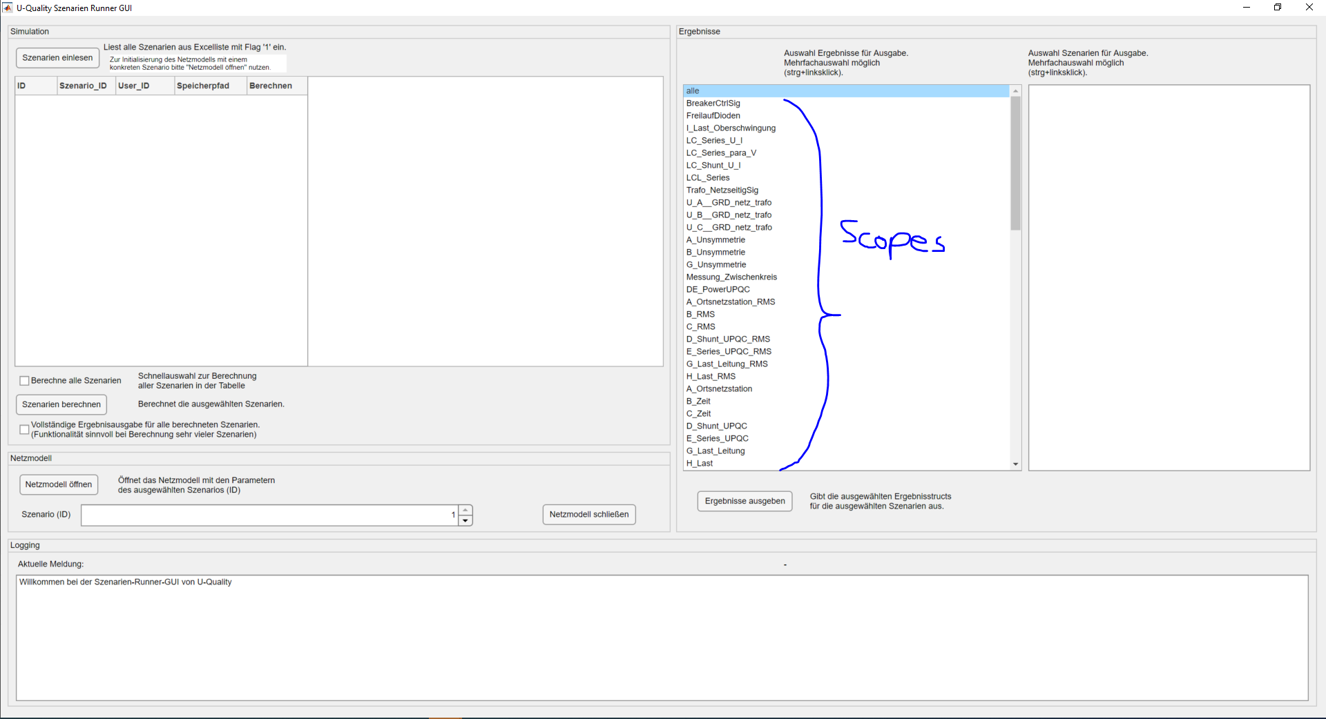
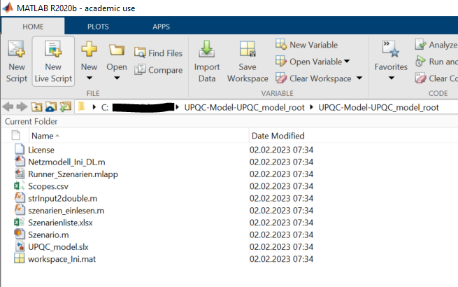
Info
Here are the active scopes listed. You can find the scopes in the file Scopes.csv…

Slide 6
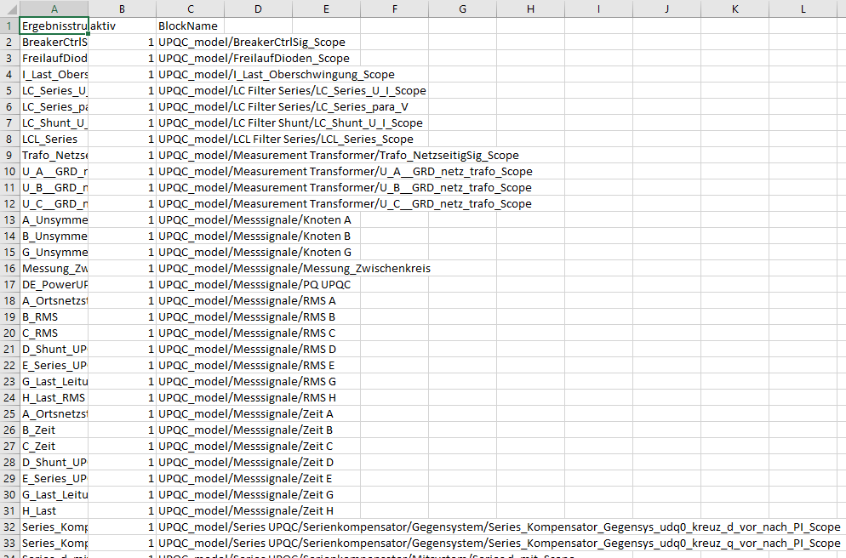
Info Scopes.csv
When you want to have less scopes saved or displayed here you can give them a 0. Then the scopes are no longer in the App ‚Runner_Szenarien.mlapp’ when you start the App again.
You can open the Scope.csv with right-click and then ‘Open outside Matlab’

Slide 7
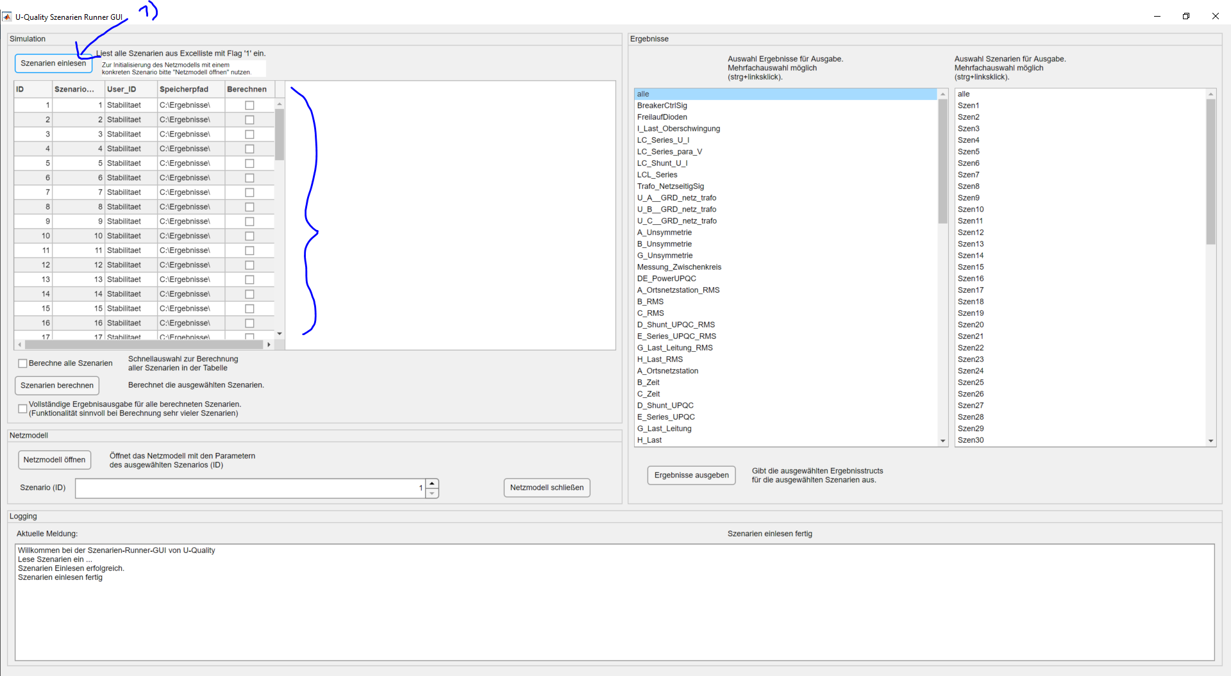
Use App for Read in
3)
Back to the App…
You can read in the scenario by clicking here
You will see here a information for success /confirmation
The scenarios will be explained. They are defined in ‚Szenarienliste.xlsx‘ 3)
2)

Slide 8
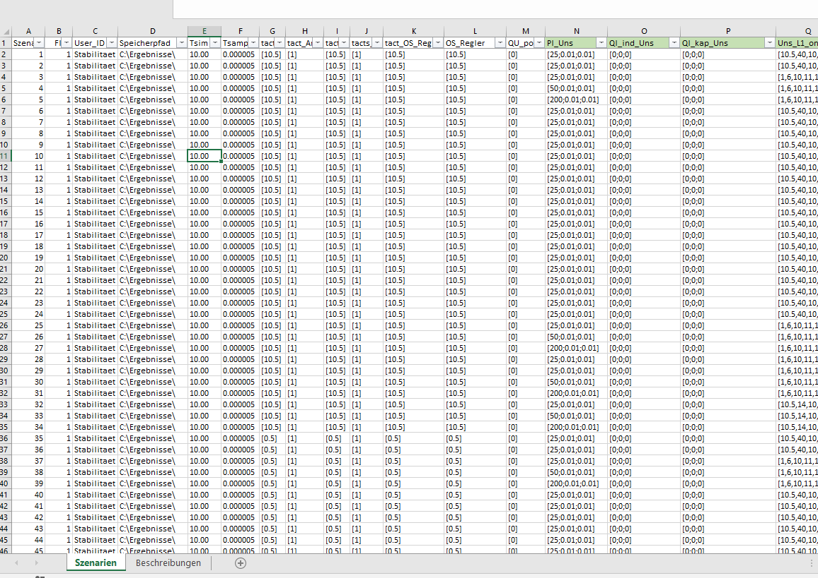
Info See Scenarios
Open the ‚Szenarienliste.xlsx‘ outside of Matlab
Here you can see the scenarios. Don‘t change the scenario in the first place.

Slide 9
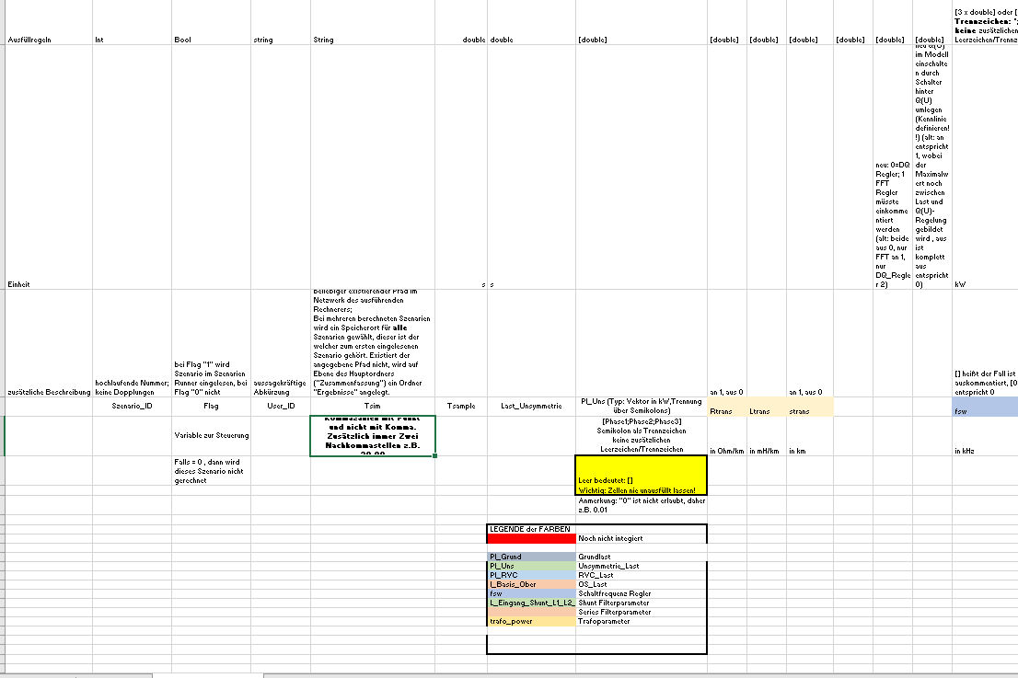
Info “Beschreibung”
In the second Tab you can find a description (“Beschreibung”).

Slide 10
Info Variables
Here are the meaning of the colors of the variables for your information. This may be help you later…

Slide 11
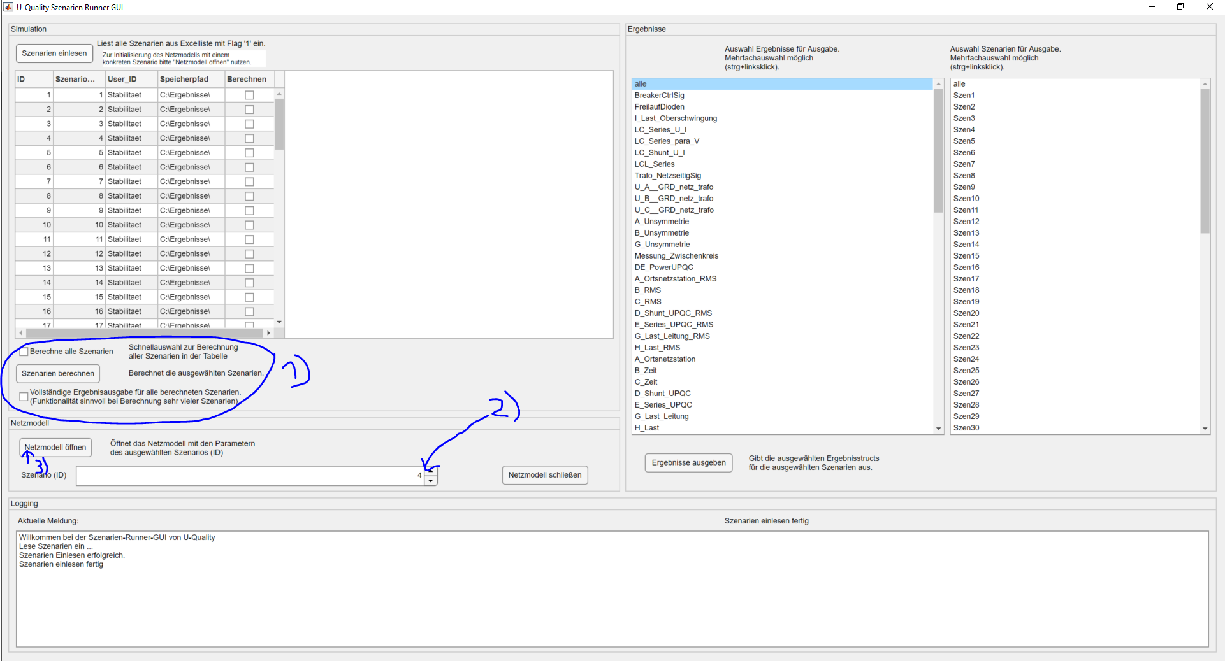
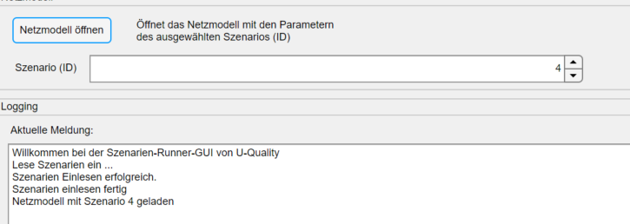
Use App start scenario
Here you could calculate more scenario, but for now we ignore this
Chose a scenario here
Scenario 4 has no controller, because turn on (tacts=10,5s) is after the simulation time (Tsim=10s) ends
Start the scenario here
Wait up to 3 minutes!
Now the model should be open.
You can see the message in the box.

Slide 12
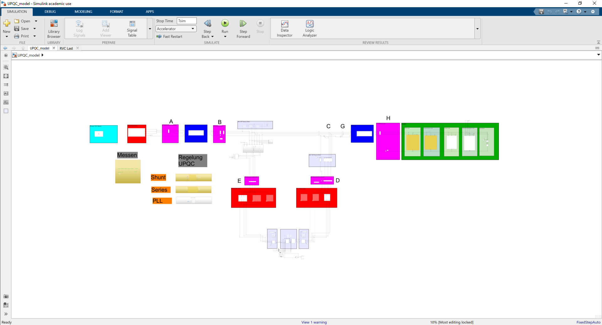


Use run the model
1)
Now you can see the model.
Run the model with the click on run
Wait a while…
You can see the model compiling
and running

Slide 13
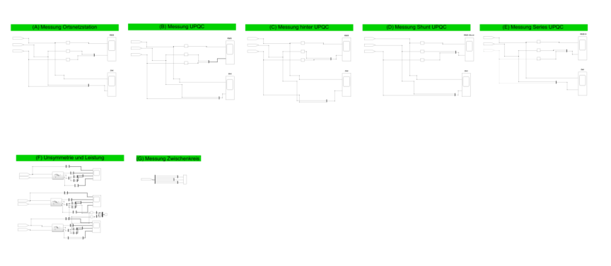
Info
Here you can open scopes
The Scopes have the same name like purple the measurement points (A to H) with F and G special measurements for the unbalance and DC-link
The control (of shunt) you can see here
2)
1)

Slide 14
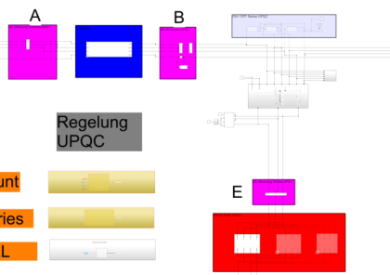
Use scopes
Try out some scopes in this screen
For scenario 4:
For example you can see there is at 1) the rms value and the time value of the voltage source (grid)
At 2) you can see at the measurement point ‚E‘ that no current flows, because the controller is off.
1)
2)

Slide 15
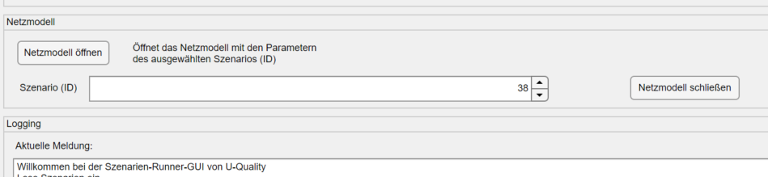
Use another scenario
1)
1) Close the model, don‘t save any changes
2) Chose scenario 38 in the app!
And click open the model
3) Now the controller is turned on, tacts=0.5 is in simulation time Tsim (see picture 3) in the szenarienliste.xlsx)
2)
3)

Slide 16
Use run the model
1)
Run the model with the click on run
Wait a while…
You can see the model compiling
and running

Slide 17
Use scopes
Try out some scopes in this screen
For scenario 38:
At 1) unbalance of measurement point ‚B‘ and ‚C‘ show the improvement from the load to the grid
At 2) you can see at the measurement point ‚E‘ the controller values of the shunt controller
At 3) The 3-phase active and reactive power is displayed for point ‚B‘
At 4) the DC-Link voltage and the current are shown
1)
4)
3)
2)

Slide 18
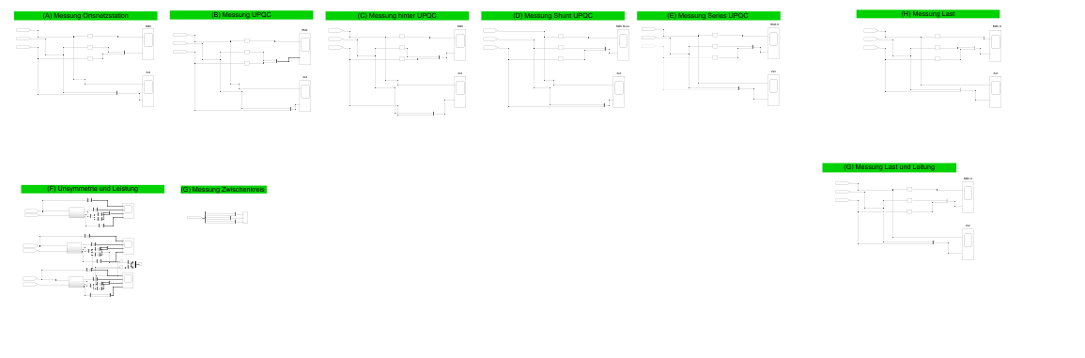
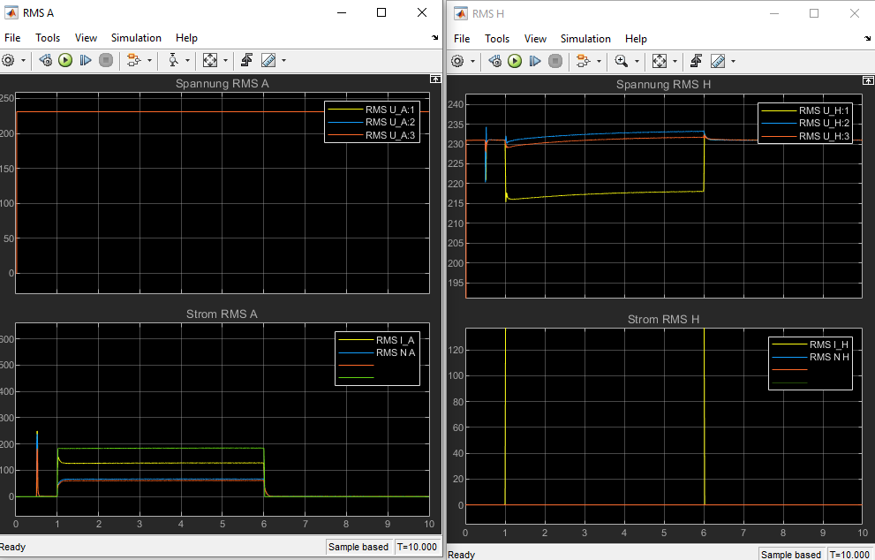
Use scopes
1)
3)
4)
Try out some scopes in this screen
For scenario 38:
At 1) You see the voltage at the transformer (source)
At 2) You see the voltage at loads
At 3) you see the voltage and current from the shunt for charging the DC-Link
At 4) you see the voltage and current from the series inverter for balancing the grid
At 5) You can see the unbalance is decreasing
1)
2)
5)
2)

Slide 19

Info understand the model
Don‘t close the model.
Please read now the document :
Performance Analysis of a 50 kVA Unified Power Quality Conditioner Model for Low Voltage Distribution Network Application_v3.pdf
The whole model is explained there.

Slide 20
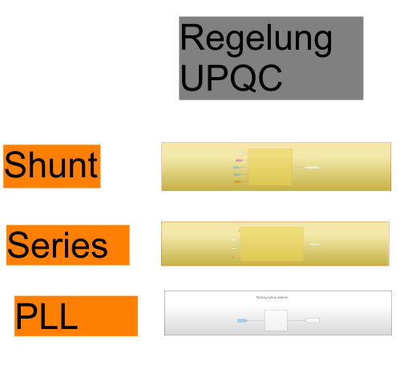
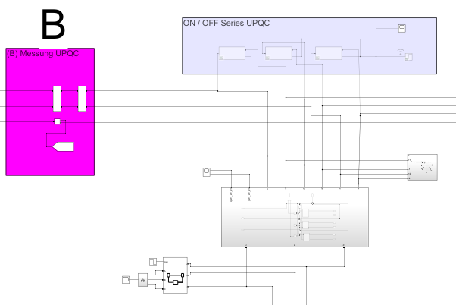
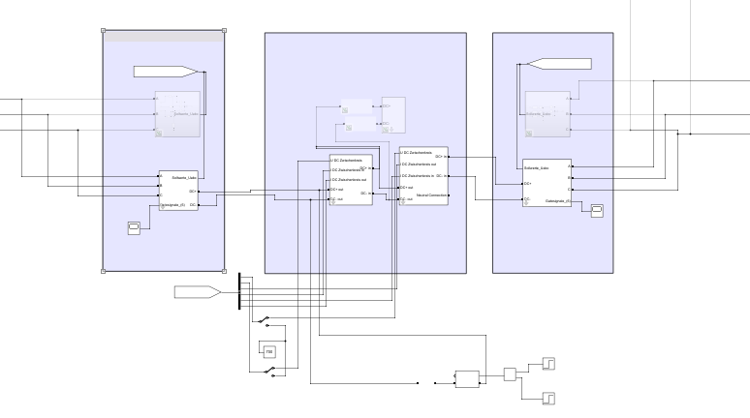
Info understand the model
1)
At 1) is the control of the shunt path
At 2) is the control of the series path
At 3) is the PLL
At 4) is the series transformer of the UPQC
At 5) You can see the DC-Link and the controlled „Hardware“ of the shunt and series controller
2)
4)
3)
5)

Slide 21
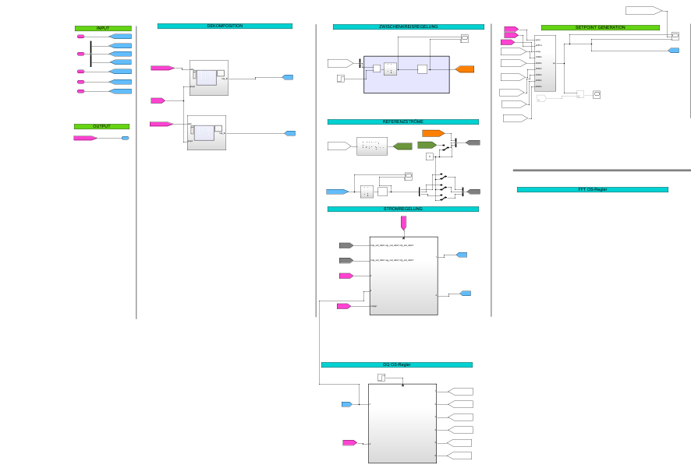
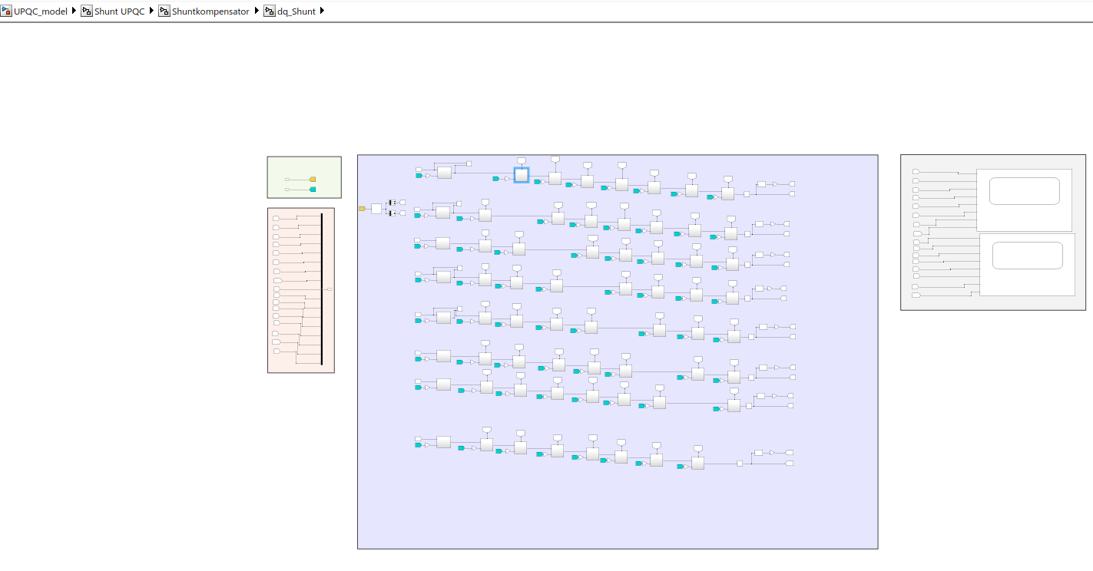
Info understand the model
1)
At 1) is the control of the shunt path
2) shows the input
3) shows the decoupling of the different frequencies and in 4) more in detail
5) Is the current controller…
The reference current can be changed at 6)
2)
3)
6)
5)
4)

Slide 22
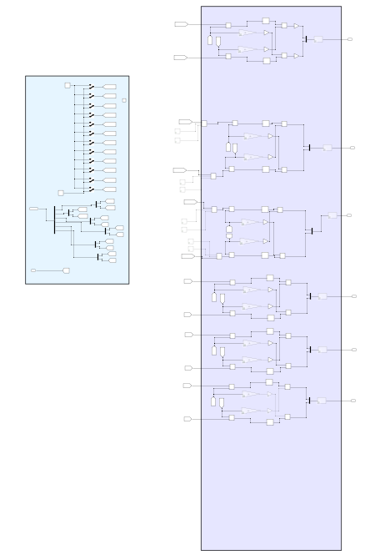
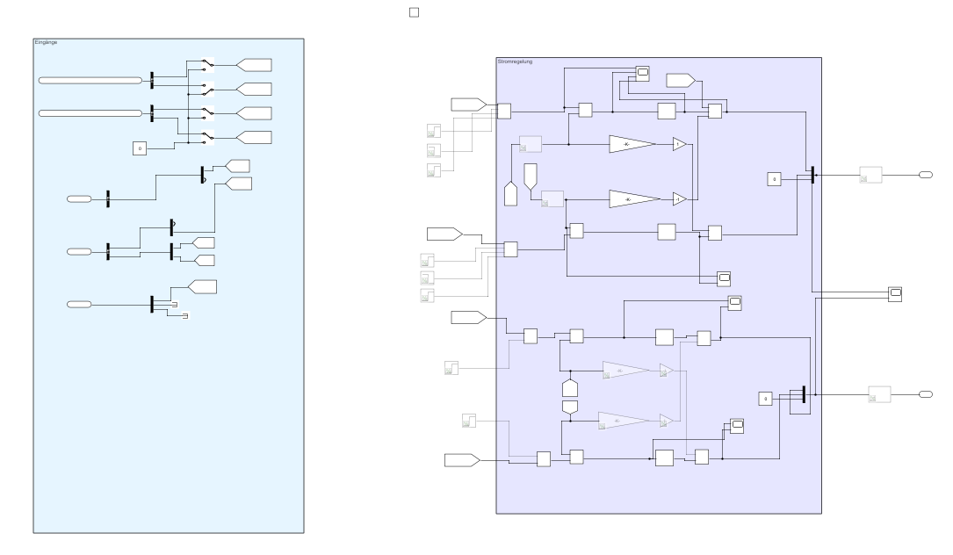
Info / Use understand the model
5)
At 5) the current controller has at 6) the control parameters of the positive sequence component ‚CC_Kp‘ and ‚CC_Ki‘ and the negative sequence component CC_Kp_geg and CC_Ki_geg. Here other parameters can be tried out. You will see how to manage the unbalance control here.
7)
At 7) the controller for harmonics is shown. At 8) you can see which frequencies are controlled with the current control. You can try to change the frequency here and at the decoupling for improve different harmonics.
6)
8)

Slide 23
Info / Use understand the model
1)
2)
At 1) the DC voltage is hold for the DC-link. At 2) the setpoints are given to 3) where the PWM is formed. Here it is possible to try your own setpoints for your own control. The 4) DC –link can switched to a constant voltage for testing by a constant voltage source (at 5)).
5)
3)
4)

Slide 24
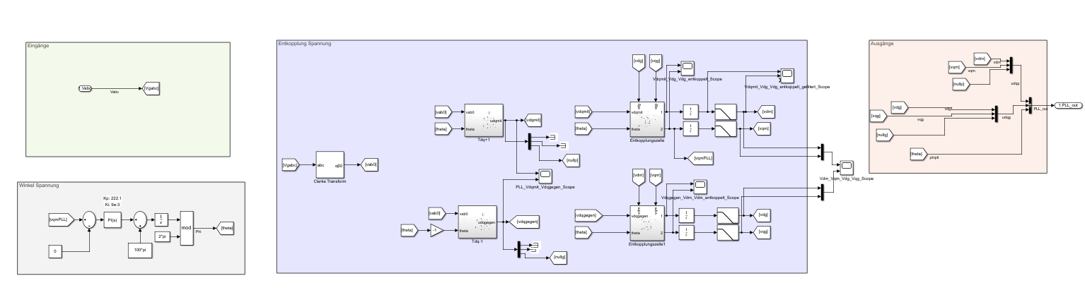
Info understand the model
1)
At 2) is the control of the series
At 3) is the PLL. The PLL is made for an unbalance voltage input. At 4) the angle of the voltage is measured. At 5) another decoupling is performed. It is possible to filter these signals 6).
2)
3)
5)
6)
4)

Slide 25
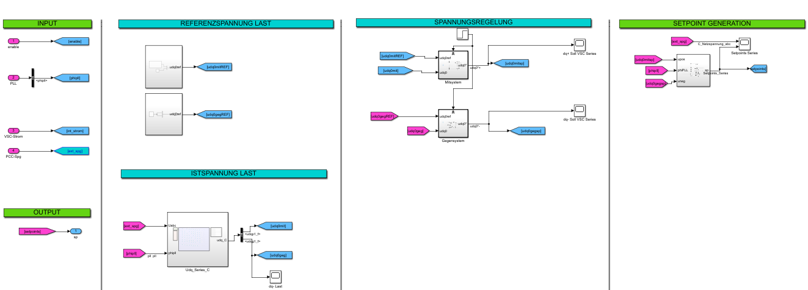
Info understand the model
1)
At 2) is the series controller. 3) With the standard voltage as the reference for the controller. The 4) decouples the frequencies, but is not controlling them. For a handover of decoupled signals to the voltage controller in 5), which controls the positive sequence component and the negative sequence component. And gives the setpoints to the controller mentioned before in 6).
2)
3)
5)
6)
4)

Slide 26
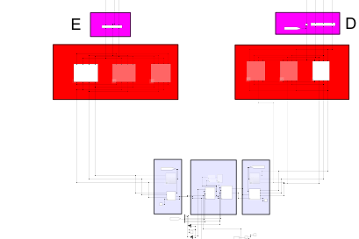
Info /Use the model
3)
1)
With the series controller in 2) as for the shunt controller the current of the controller is flowing through the filters at 3), (which are theoretical changeable but not recommend for the here presented control). and the transformer in 4) the values of this transformer can be changed here. It is also possible to switch on the scopes. Additional it is possible to bypass the transformer for example to try out the shunt controller on its own.
2)
4)
5)
4)

Slide 27
Use Some further possibilities
Look at the model again.
Now you can try your own modifications
Try to add and change the blocks for different harmonic control
Try another length of line model
Try to change the transformer of the series path
Try different reactive power controls
Try different filter and parameter for your control
Change the scenarios for your controls ☺

Slide 28
Thanks for your attention!

